Slide 1

BLOCKCHAIN
Sunitha R
Department of Computer Science Engineering

Slide 2

BLOCKCHAIN
Hash Functions
Sunitha R
Department of Computer Science Engineering

Slide 3
BLOCKCHAIN
Course Content
Learn about the hash code generation and how it can be used in blockchain.

Slide 4
BLOCKCHAIN
Hash Function – Properties
Deterministic
Pre-Image Resistance
Collision Resistant
Small Changes In The Input Changes the Hash
Puzzle Friendly
Quick Computation

Slide 5
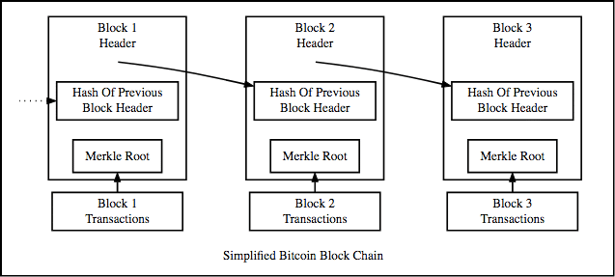
BLOCKCHAIN
Bitcoin Blockchain

Slide 6
BLOCKCHAIN
Data structures
Pointers
Linked Lists

Slide 7
BLOCKCHAIN
Block Header
A block header contains:
Version: The block version number
Time: the current timestamp
The current difficulty target
Hash of the previous block
Nonce
Hash of the Merkle Root

Slide 8
BLOCKCHAIN
Merkle Tree – Organization of Hash Pointers in a Tree
Root Hash
H_{root}=Hash(H₀+H₁)
Merkle Root
L₁ Hash
H₀= Hash(H₀₀+H₀₁)
L₁ Hash
H₁=Hash(H₁₀+H₁₁)
L₂ Hash
H₀₀=Hash(T₁)
L₂ Hash
H₀₁=Hash(T₂)
L₂ Hash
H₁₀=Hash(T₃)
L₂ Hash
H₁₁=Hash(T₄)
T₁
T₂
T₃
T₄

Slide 9
BLOCKCHAIN
Supplementary readings
https://ieeexplore.ieee.org/document/8431963
https://ieeexplore.ieee.org/document/8847331
https://ieeexplore.ieee.org/document/8760885
https://ieeexplore.ieee.org/document/8917564

Slide 10
THANK YOU
Sunitha R
Department of Computer Science Engineering
sunithar@pes.edu
+91 80 6666 3333 Extn 721

